Slide 1
Prediction models on diamond price
Zhenming Yang
932784300
Notes:
Hello everyone. I am Zhenming yang a Meng student who is major in cs. I am glad to give one presentation today

Slide 2
Project description
Final project of CS 540
Finished with R language
Combined with crawler and data analysis
Compare four machine learning models
Notes:
Let us begin. It is a diamond price predict engines which combined with three different machine learning models. Why I would use that is because the main part of the project is realized by myself. And I did learn a lot from this project such as the R language and machine models even some statistic knowledge

Slide 3
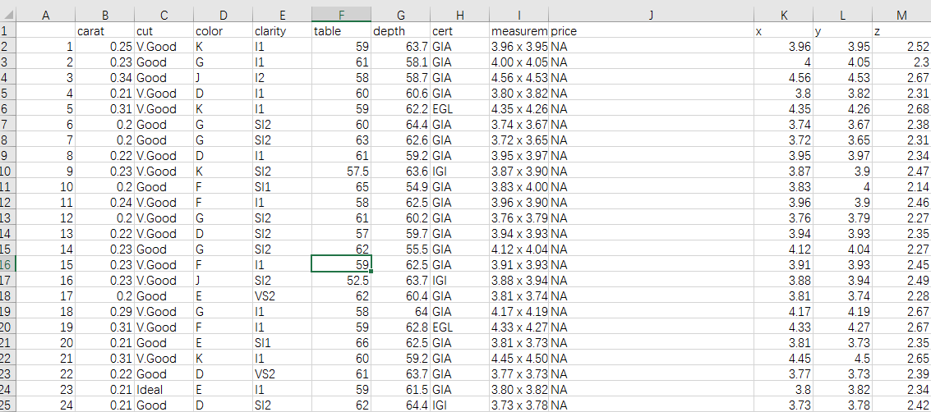
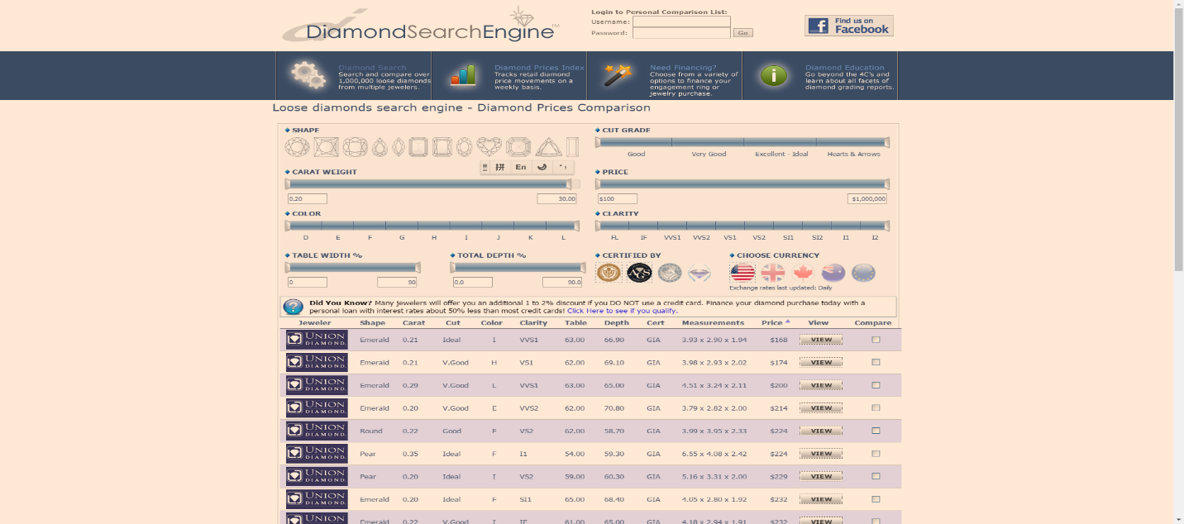
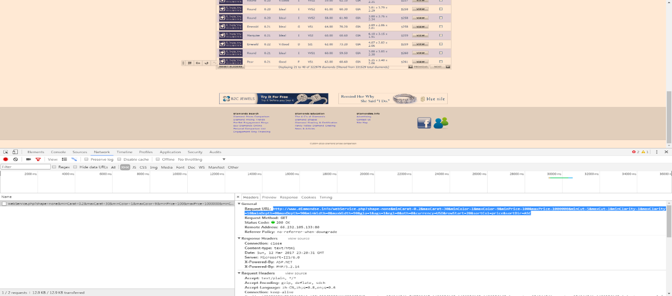
Source of data
All data from diamond search engine
http://www.diamondse.info/diamond-prices.asp
Analysis and collected with R crawler- rverst
More than 500000 round diamonds info collected (15/10/2017)
Notes:
So let look at the data source. All data are from the well-known website diamondse. At the beginning, I just use phantomJs (which is a headless browser realized in Javascript) to collect the data. Write 10 pages’ info into one single csv file. But I change it into R crawler-revest for better performance. Finally, I got almost 600 thousand diamonds info.

Slide 4
Source of data
Separate measurements in to x, y, z.
Omit NA and 0 values.
Price, carat, table, depth：Numerical variables
Shape: Round
Cut: 3 grades ( Good, V.Good, Ideal)
Color: 9 grades (D,E,F,G,H,I,J,K, L)
Clarity: 9 grades (IF,VVS1,VVS2,VS1,VS2,SI1,SI2,I1,I2)
Cert: 9 grades ( GIA, AGS, EGL,IGI,HRD,EGL USA, EGL INIFI, EGL ISRAEL, Others)
Notes:
Next part is pretty important for the whole processing. Data cleaning and analysis. The results are shown as here. What I did is remove duplicate data and omit the missing values. Some numerical variables. Such as price, carat. Table and depth. Others such as cut, shape and color are descriptive variables. Details are listed as here.

Slide 5
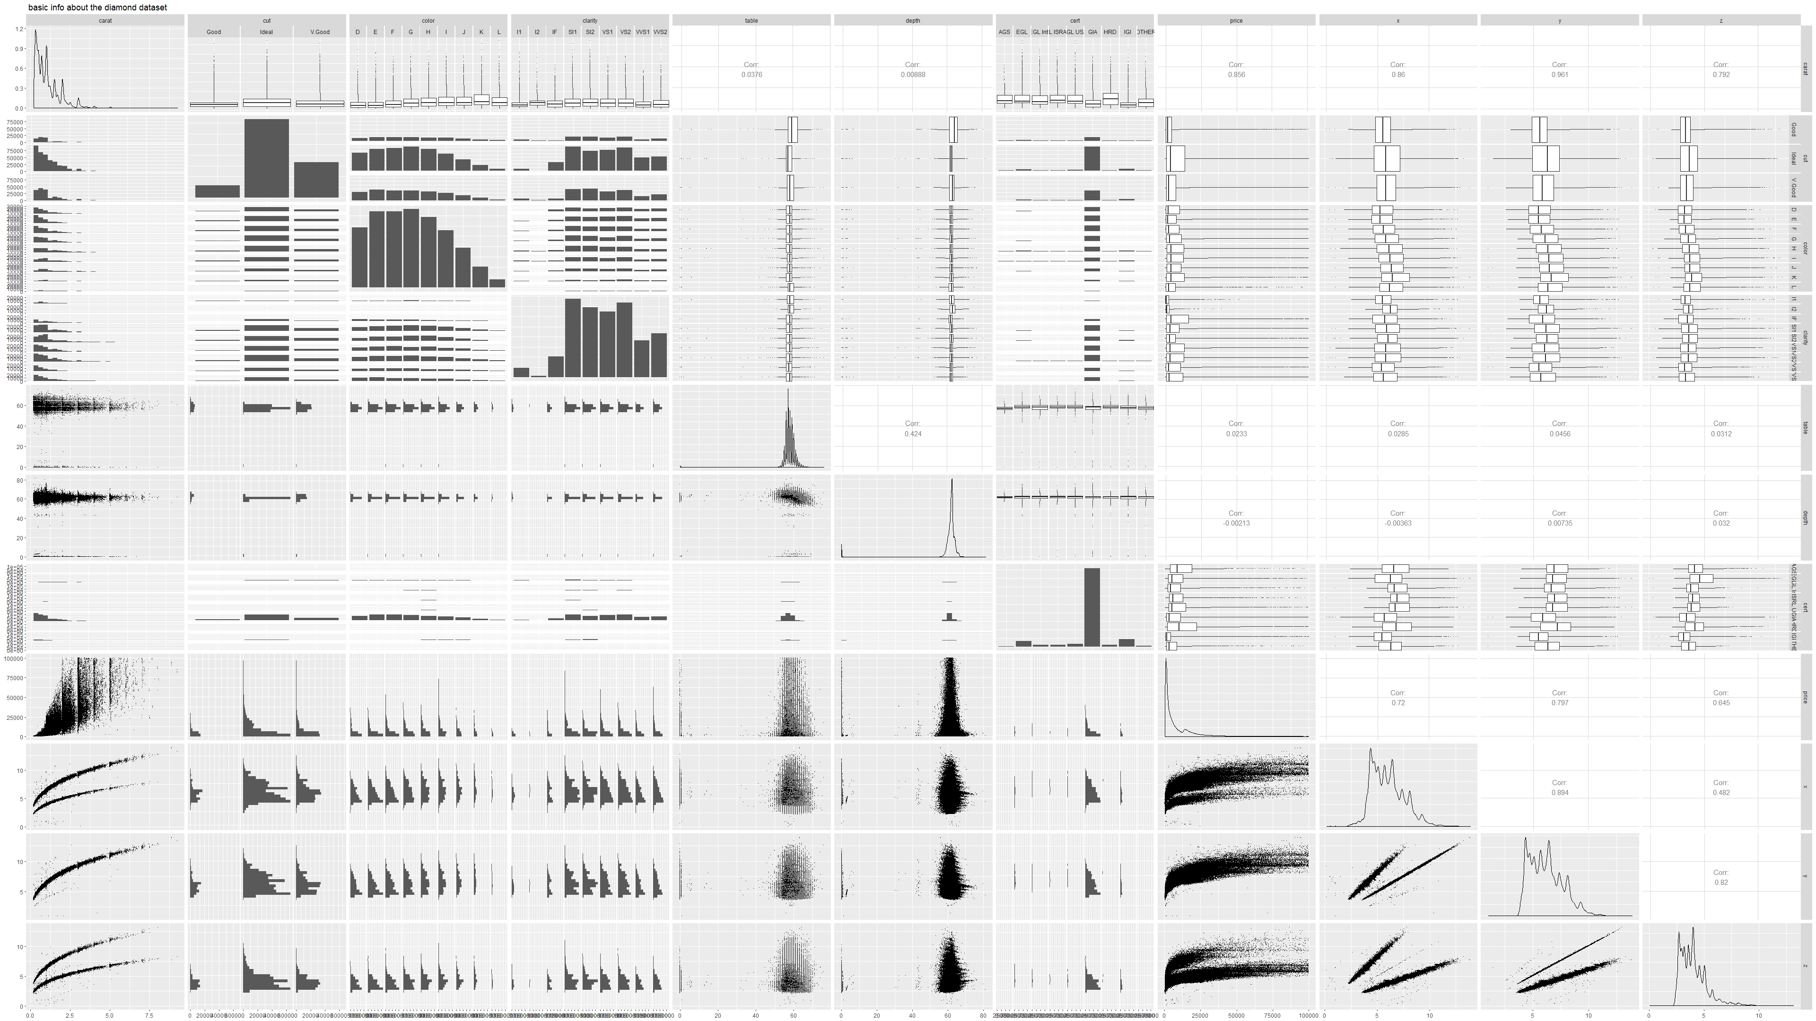
First step: general analysis
Carat
Cut
Color
Clarity
Table
Depth
Cert
Price
X
Y
Z
Notes:
First I just general analysis the relationships between every two variables. The plot is shown here. If two demission are number variables that plot will be a line chart or scatter plot. Otherwise the plot will show the distribution of the variable. As we want to predict the price. So we just focus on this line.

Slide 6
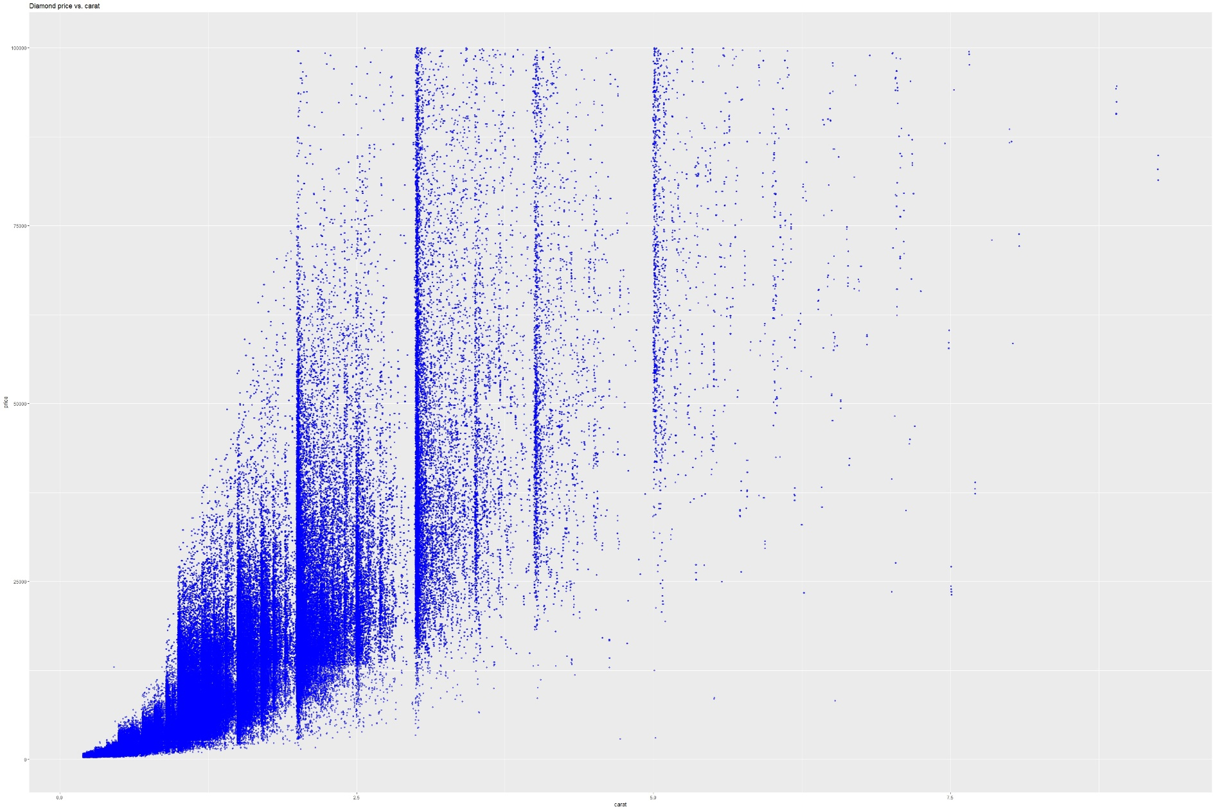
First step: general analysis
Notes:
This plot shows the relations between price and carat. We can tell that there is one positive trend between the price and carat. The convergence(收敛) of that is not that so good.

Slide 7
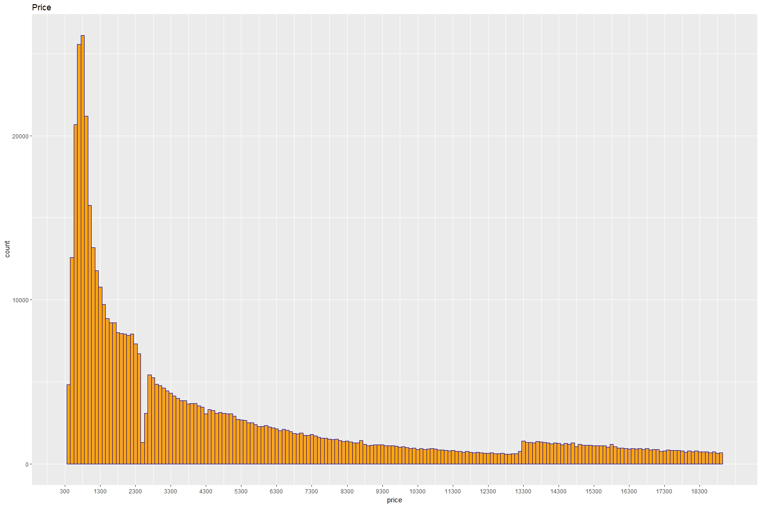
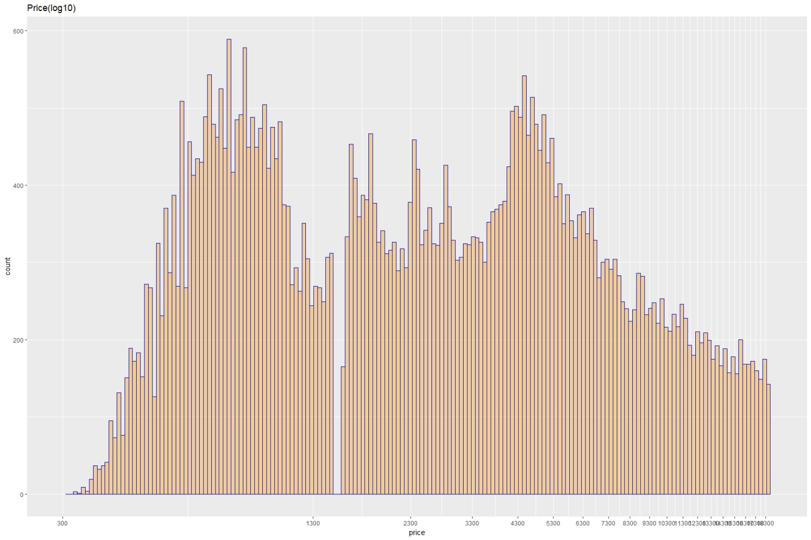
First step: general analysis
Notes:
And this plot shows the distribution of price. It is positive skewness(偏态). We know that normal distribution is only in ideal condition. So I just use one common way in statistic field. Transform the price with log10. This is a common way to make data easier to describe.

Slide 8
First step: general analysis
Notes:
And the fact is the transform is one effective way to treat the price variable. It is much better than the original price variable.

Slide 9
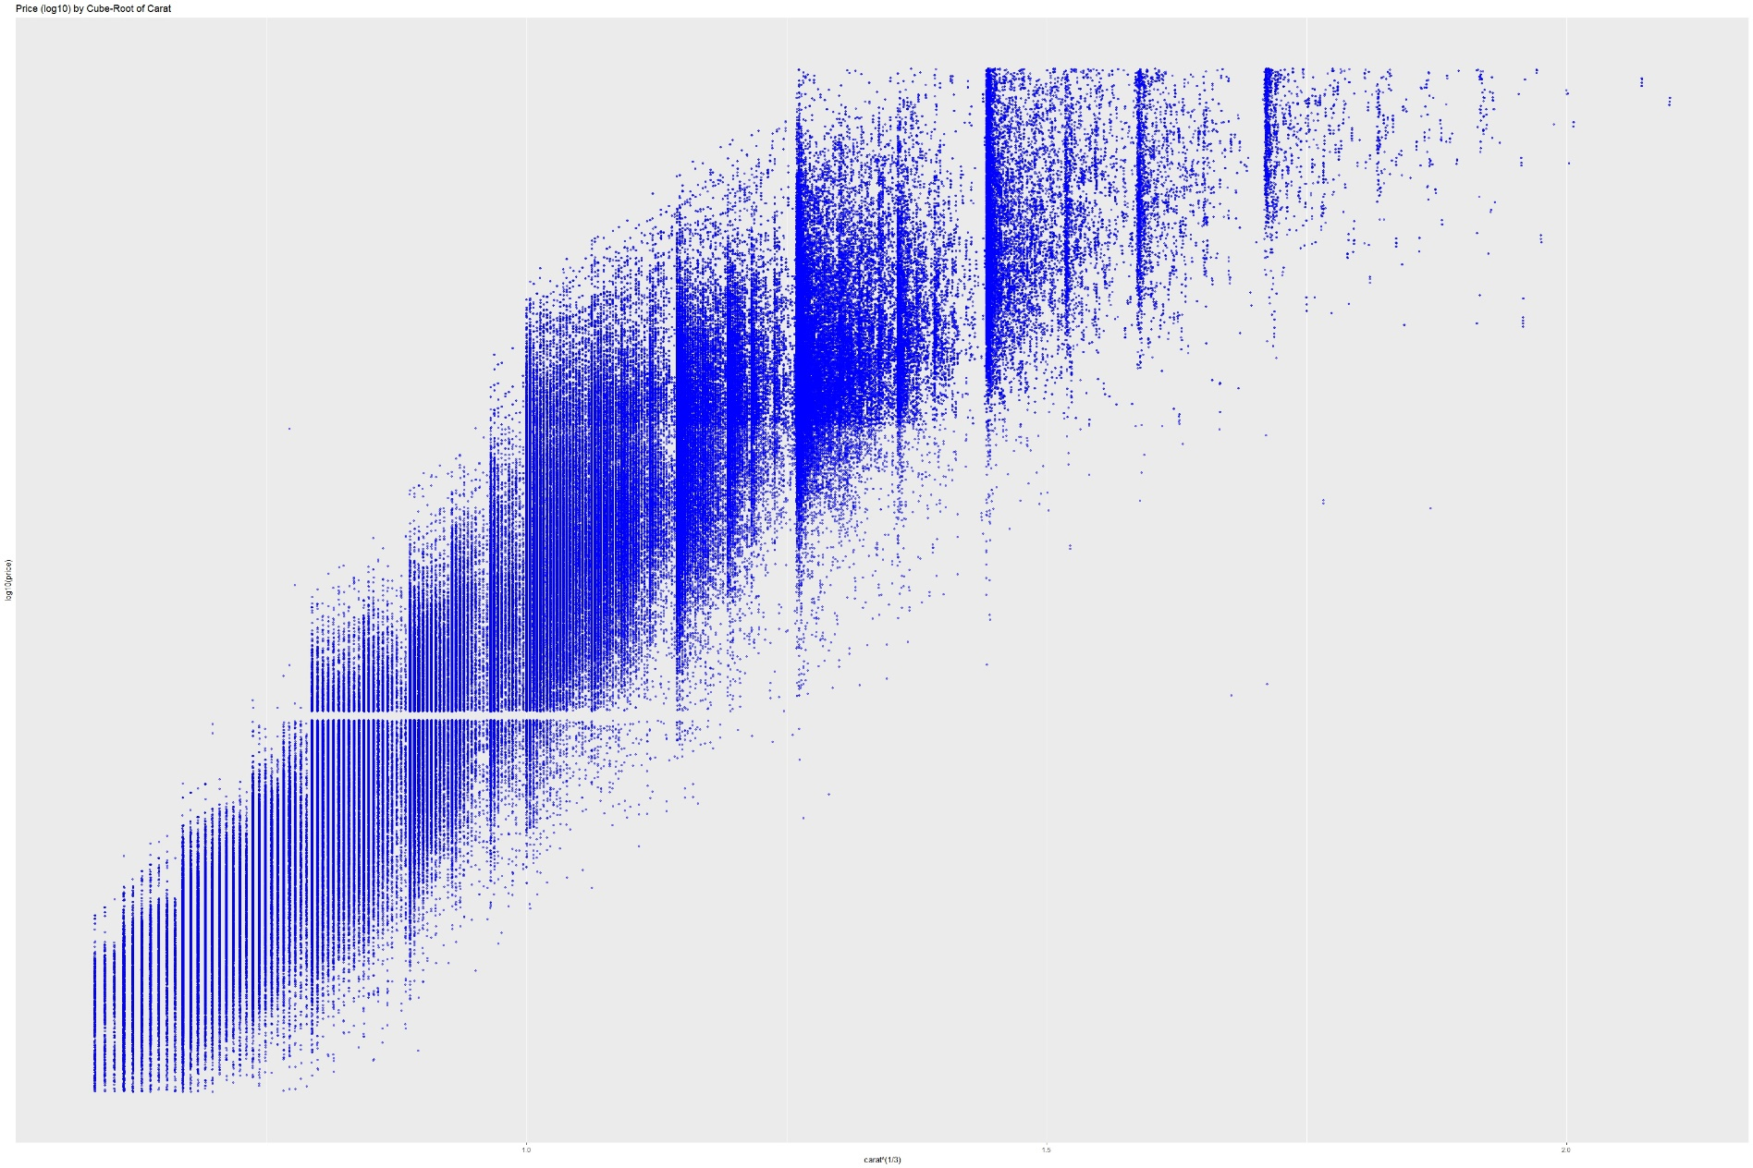
First step: general analysis

Slide 10
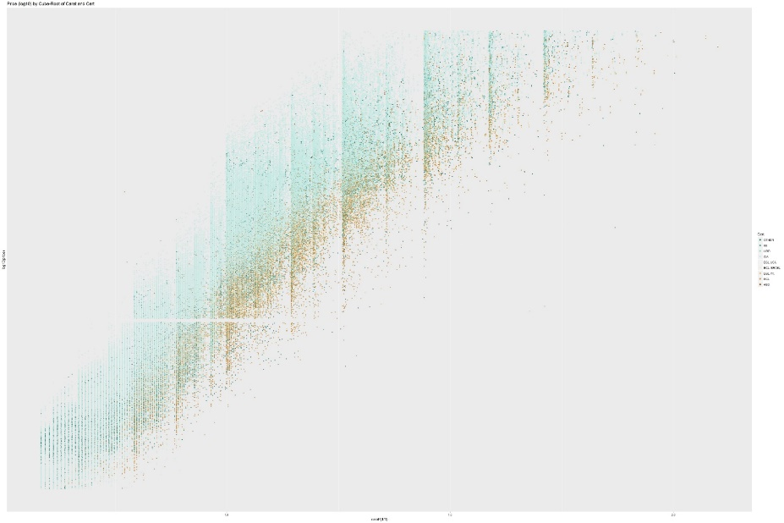
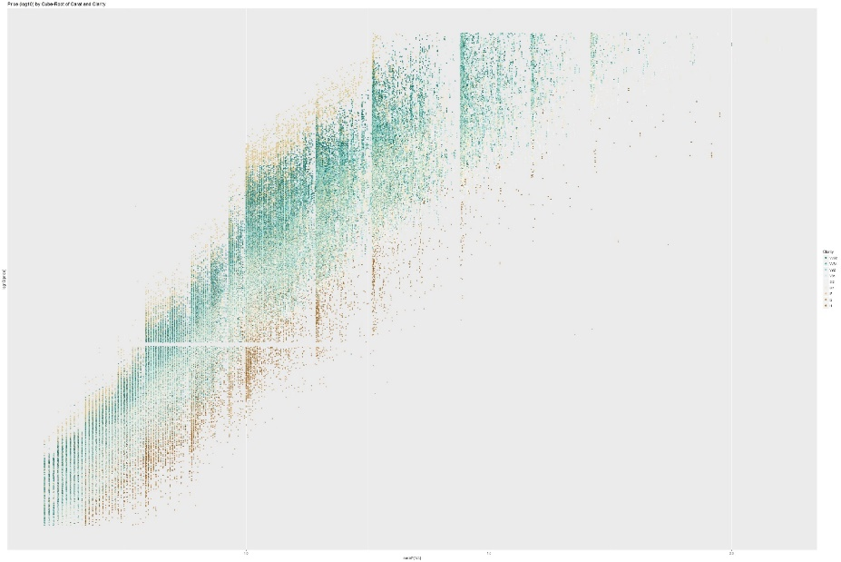
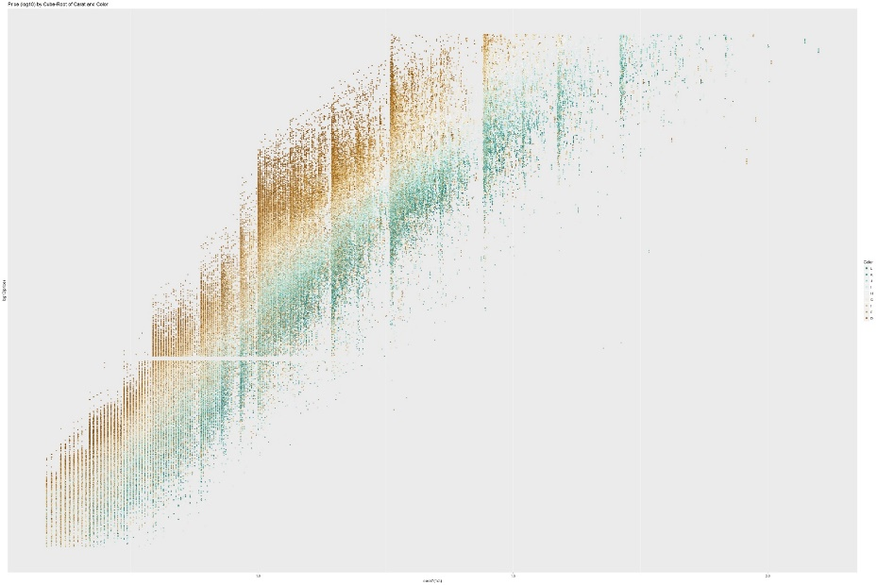
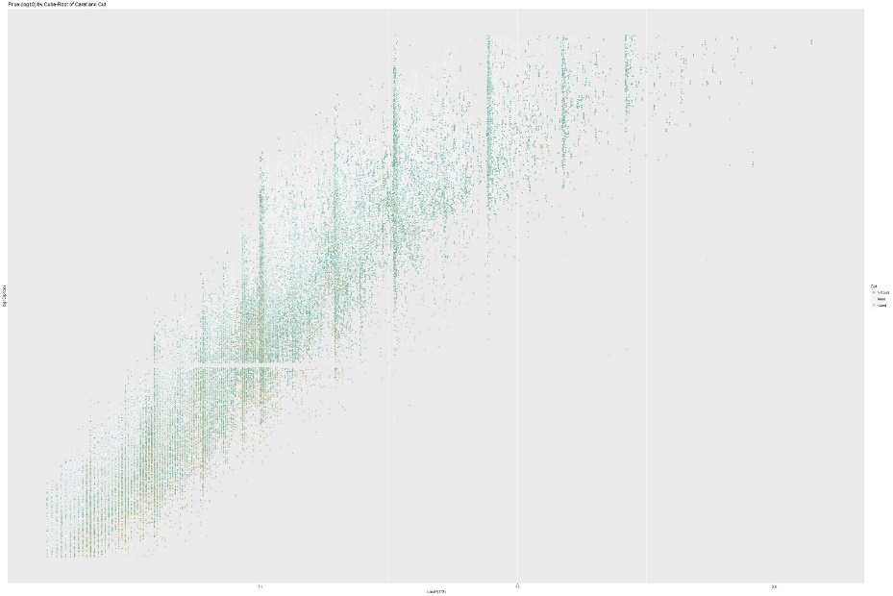
First step: general analysis
Clarity
Cert
Color
Cut
Notes:
After transform. The relations between price and other variables as shown. We can see the sense of hierarchy is pretty good.
Next part I will mainly describe how I utilize the data and generate the models
Btw the ratio of training dataset and testing dataset is 85: 15

Slide 11
Model 1 : Multilinear regression
Is a linear approach for modeling the relationship among a scalar dependent variable y and one or more explanatory variables.
Often fitted using the least squares approach.
Step function used to optimized linear model
AIC value was used to determine model
Notes:
Based on the data. The first model I build is the multilinear regression. That is the most common model used in statistic area which is realized with least squared method.
The key point is to find reasonable transform of each variable. Here I just compare the default linear model and the one I refined.

Slide 12
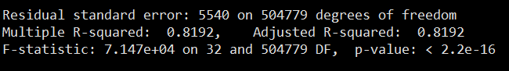
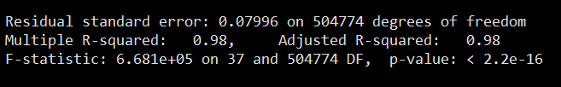
Model 1 : Multilinear regression
Basic model: lm1=lm(price~carat+cut+clarity+color+cert+table+depth+x+y+z, data=train)
Optimized model: lm2=lm(I(log10(price)~I(carat)^(1/3))+carat+cut+clarity+color+cert+table+depth+x*y*z ,data=train)
Notes:
The result proved a lot. Residual standard error and p r-squared both.
P values small enough mean we can trust and use both models to predict the price.

Slide 13
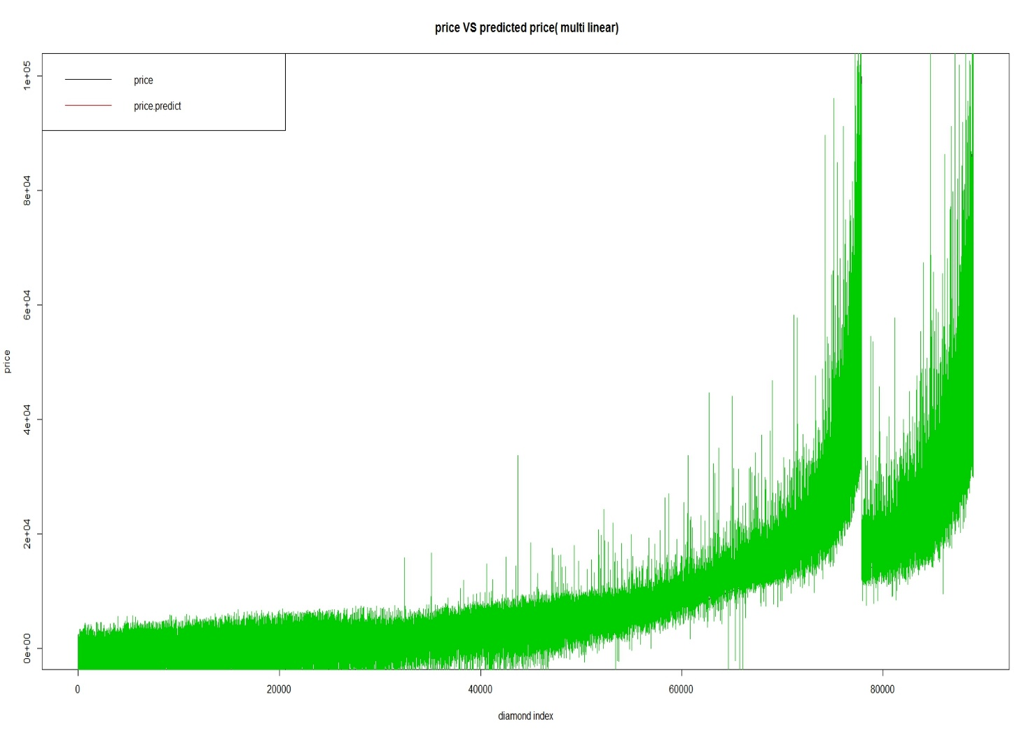
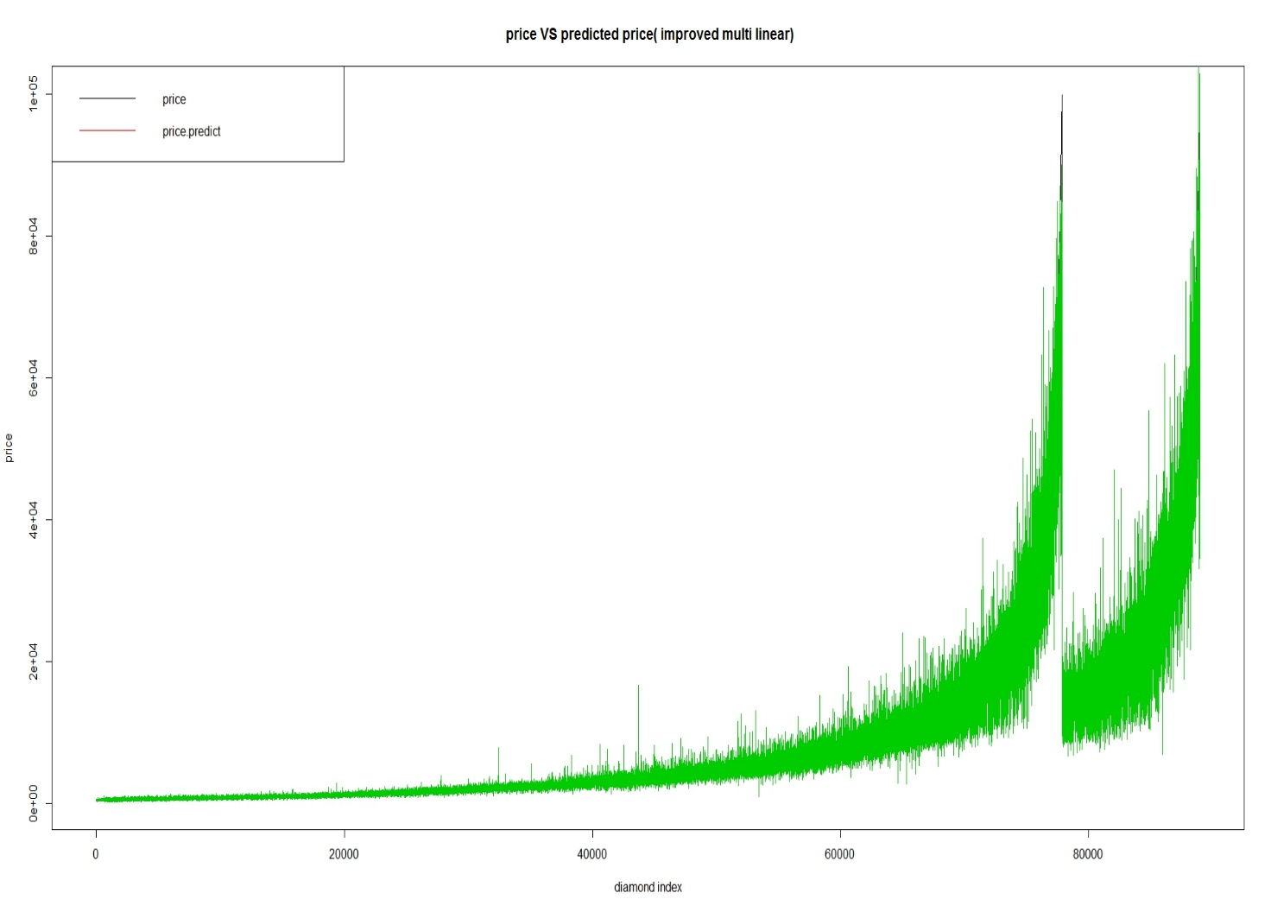
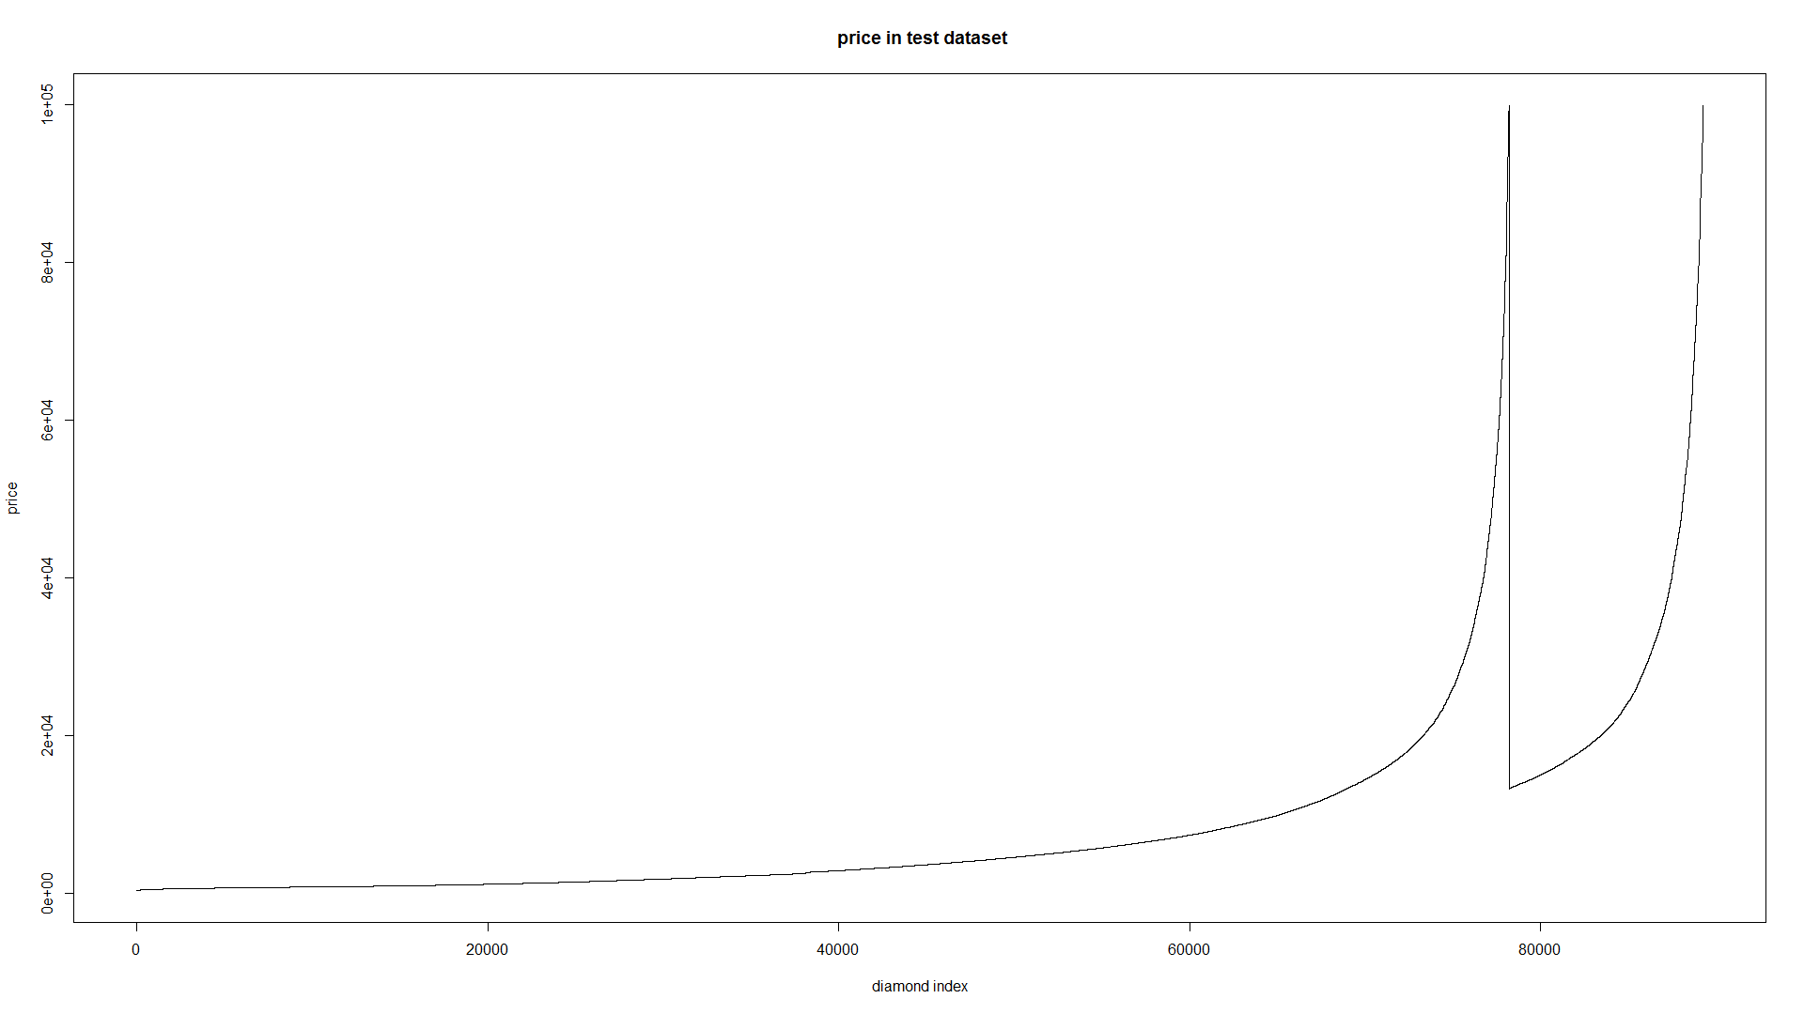
Model 1 : Multilinear regression
Notes:
This plot shows the how the model fitted the test dataset.

Slide 14
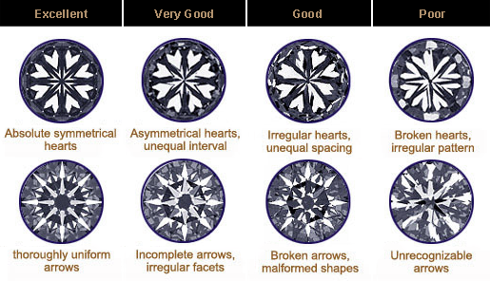
Model 1 : Multilinear regression
One excellent diamond should meet：
Total depth :(60-62%)
Table Percentage :(55-58%)
Crown Angle: (34-35°)
Pavilion Angle :(40.5°)
Pavilion Depth Percentage :(42.5-43.5%)
Star Facet Length Percentage:
(55-60%)
Lower Girdle Facet Percentage: (70-75%)
Girdle Thickness: Medium
Notes:
I really learned a lot from training this linear model. The most famous properties of round diamond is arrows and hearts diamonds, Which are considered as most valuable round diamonds are related with these features. The hearts and arrows only could be seen in round diamond and all properties in a certain range.

Slide 15
Model 2 : KNN
Is a non-parametric method used for classification and regression.
The output is the property value for the object.
Sensitive to local structure of the data.
KKNN: one knn implementation in R language
Notes:
The second model is based on KNN, It is a non-parametric method used for classification and regression. That will calculate the avg of k nearest neighbors' price The knn models are realized with the help of KKNN.

Slide 16
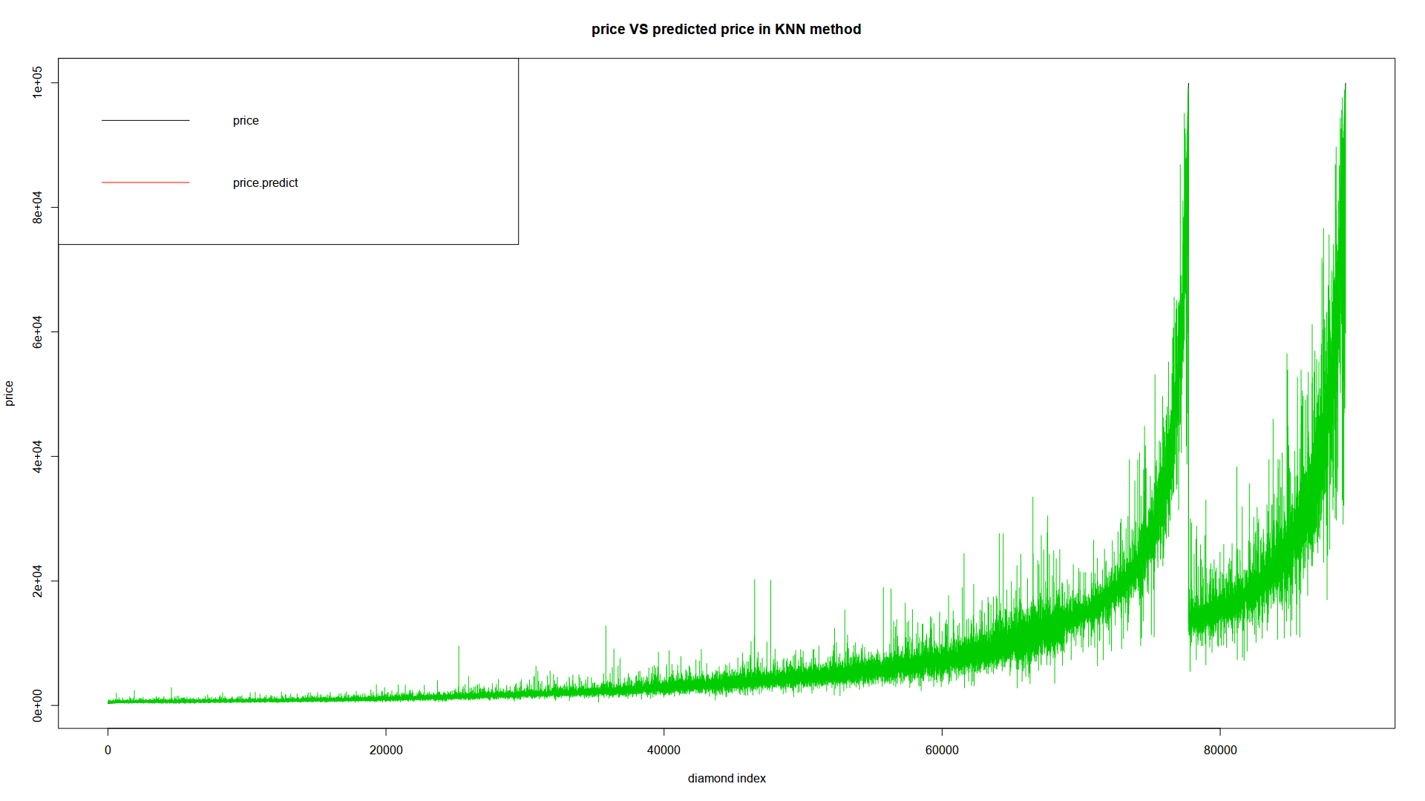
Model 2 : KNN
Basic parameters:
K :3
Distance:2 (Euclidean distance)
Notes:
K means the number of neighbors we considered. After several test I finally use 3 as number of neighbors. Distance is the params of minkersiki distance. Here we use Euclidean distance. The fitting plot is shown here.

Slide 17
Model 3 : Random forest
One classifier with multiple regression trees
Random regression forest correct for regression trees’ habit of overfitting to their training set
Ranger, implemented as in the original Random Forest(Bremian 2001)
Notes:
When talk about the third one.
Random forest.
One classifier with multiple regression trees. Which I think provides a better result than the regression tree model.
Basic params listed here. Even with 8 threads. It costs about 10 mins to build the model. The knn model is even longer.
Without parallel. It costs more than 30mins.

Slide 18

Model 3 : Random forest
Basic parameters:
Num.trees:600
Mtry:3
Num.thread:8
Split rule: variance
Classification: FALSE

Slide 19
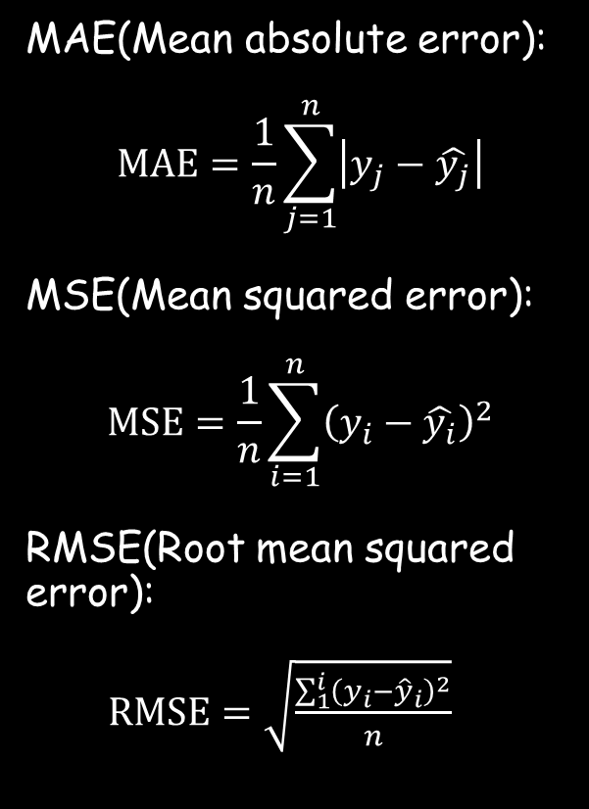
Model evaluation
MAE(Mean absolute error):
$$MAE=\frac{1}{n}\sum_{j=1}^{n}{\left|y_{j}−\hat{y_{j}}\right|}$$
MSE(Mean squared error):
$$MSE=\frac{1}{n}\sum_{i=1}^{n}{{\left(y_{i}−\hat{y_{i}}\right)}^{2}}$$
RMSE(Root mean squared error):
$RMSE=\sqrt{\frac{\sum_{1}^{i}{{\left(y_{i}−{\hat{y}}_{i}\right)}^{2}}}{n}}$
 | MAE | MSE | RMSE
Multi linear Regression | 1271.523 | 10568874 | 0.0632815
K-nearest neighbor | 652.7436 | 3222374 | 0.01929406
Random forest | 499.2281 | 1647601 | 0.00986506
Notes:
The next part is the comparison. I use three popular evaluation methods in statistic to tell which method is the best. After comparison. The random forest is the winner among these three models.

Slide 20
Reference
Wang Y.-F. Predicting Stock Price Using Fuzzy Grey Prediction System. Expert Systems With Applications, 22(1), 33-38, 2002.
Grolemund, G., & Wickham, H. R for Data Science.
Statistics Solutions. What is Multiple Linear Regression.
Statistic. Random Forests.
https://www.ritani.com/blog/diamonds/brilliant-cut-diamonds/attachment/hearts-and-arrows-igl/
https://yiaimer.wordpress.com/2011/02/18/%E4%B9%B0%E9%92%BB%E7%9F%B3%E8%AE%B0-2/
Notes:
That is all thanks.

